Slide 1
SIM Swap Fraud

Slide 2
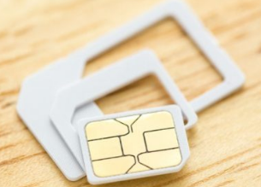
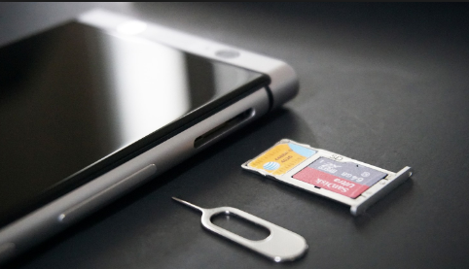
SIM Card

Slide 3
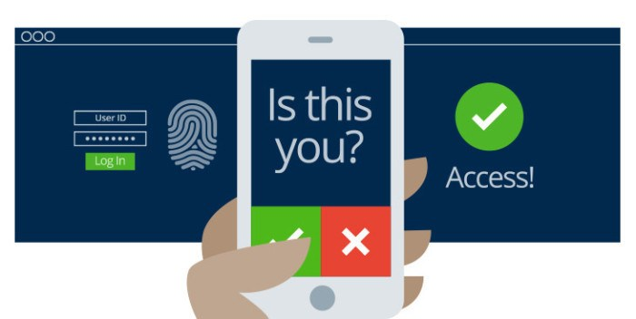
Two Factor Authentication

Slide 4
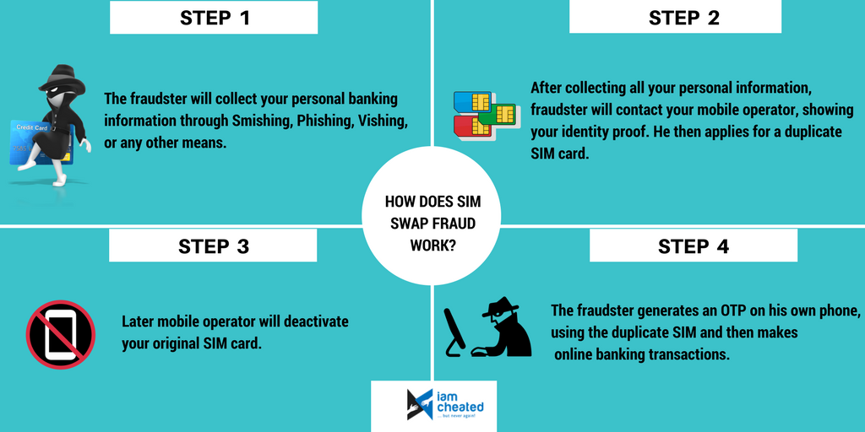
SIM Swap Fraud

Slide 5
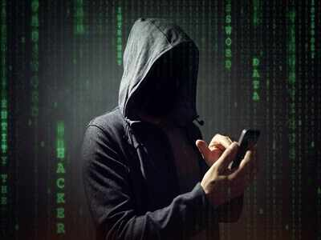
Famous Cases
Justin Bieber nudes were stolen & released from Selena Gomez’s accounts.
This week a BitCoin investor filed a Lawsuit against AT&T for the theft of $620,000 worth of tokens
Stealing and reselling “OG” user accounts (e.g. “@Fearless”)

